Slide 1
Analysis Normal Form
http://solor.io/
Healthcare Services Platform Consortium Project
https://www.hspconsortium.org/

Slide 2
The Promise
Improve the quality and safety of health-care
Measure the cost and quality of services
Integrate multiple providers across organizations in a continuum of care
Integrate high-quality decision support into the clinical workflows in the continuum of care

Slide 3
Has the Promise Been Delivered?
Improve the quality and safety of health-care*
Measure the cost and quality of services
Integrate multiple providers across organizations in a continuum of care
Integrate high-quality decision support into the clinical workflows in the continuum of care.
Analyzing encoded data is necessary to deliver the promise…
*Many quality and safety improvement opportunities still exist.

Slide 4
Architectural Separation of Concerns
P
Procedural Knowledge
Decision support and analytics
A
Define how to process measurements
(Decision support, analytics…)
Assertional Knowledge
S
HL7 FHIR, CIMI, …
Statement Model
Define how to record a measurement (Numerical and Subject of Information)
D
Definitional Knowledge
SNOMED, LOINC, RxNorm, …
L
Define what can be measured (Description Logic and Language)
Language and Dialect
F
Shared module system
SOLOR Foundation
Provides the interoperability foundation

Slide 5
Semantic Interoperability Architecture
P
Extension Module
Procedural Knowledge
A
E₁
Assertional Knowledge
E₁
S
Statement Model
Module
D
E₁ extends M₁
Definitional Knowledge
M₁
L
Language and Dialect
F
SOLOR Foundation
Versioned Modules: M₁, M₂, M₃, …

Slide 6
What is Separation of Concerns?
An architectural design principle whereby a system is divided into distinct sections, such that each section addresses a separate concern
When concerns are well-separated, individual sections can be reused, as well as developed and updated independently
Each architectural layer addresses separate concerns
Defining what is being measured is a separate concern from representation of the results of a measurement

Slide 7
What are the Implications of Separation of Concerns?
Statement layer: Recording measurement
Quantitative measurement
Existential measurement
Language and Definitional layers: Defining what is measured
Dot-blot hemorrhage of the retina
Type 1 diabetes
Measurement of absence needs to be removed from SOLOR sources to allow layers to address separate concerns

Slide 8
ANF is about Statements
ANF assumes coherence of language and definitional layers
ANF assumes a clean separation between the statement layer and the definitional and language layers

Slide 9
ANF principles
Don’t create a thousand models if one (or two) will do…
Ensure that the statement representation is:
Reproducible
Scalable
Simplicity
Reusability
Use case driven
Immutability
No False Dichotomies

Slide 10
Clinical Input Form
Clinicians typically enter information into an EHR in a certain manner: the clinical input form (CIF)
The CIF is not a literal “form”. It refers to the manner in which information is presented to the clinicians and how they enter the data, e.g.
by constraining the information to allow only certain values to be entered, such as through a drop-down list or radio button
breaking up large chunks of related information into smaller parts like in medication orders

Slide 11
ANF vs CIF
The way information is presented to clinicians should be most efficient for the clinicians to use (CIF)
What is an efficient way for clinicians to select and enter data may not be the most efficient way for data analysts to use when they are querying data
For this, the data is normalized using the analysis normal form (ANF) and stored in a database.

Slide 12
ANF Types
Performance of action, may include
passive observation of a phenomenon related to patients and their health status or family history, and
active interventions, such as providing education or administering medications
Request for action, may include
Procedure orders, consultation with other providers, or active interventions
Both are statements with topics

Slide 13
Major model components
Topic
WHAT is being observed or requested
Circumstances
HOW, WHY and WHEN a requested or performed action will be or was carried out
What, when, where, why, and how are concerns of the statement model

Slide 14
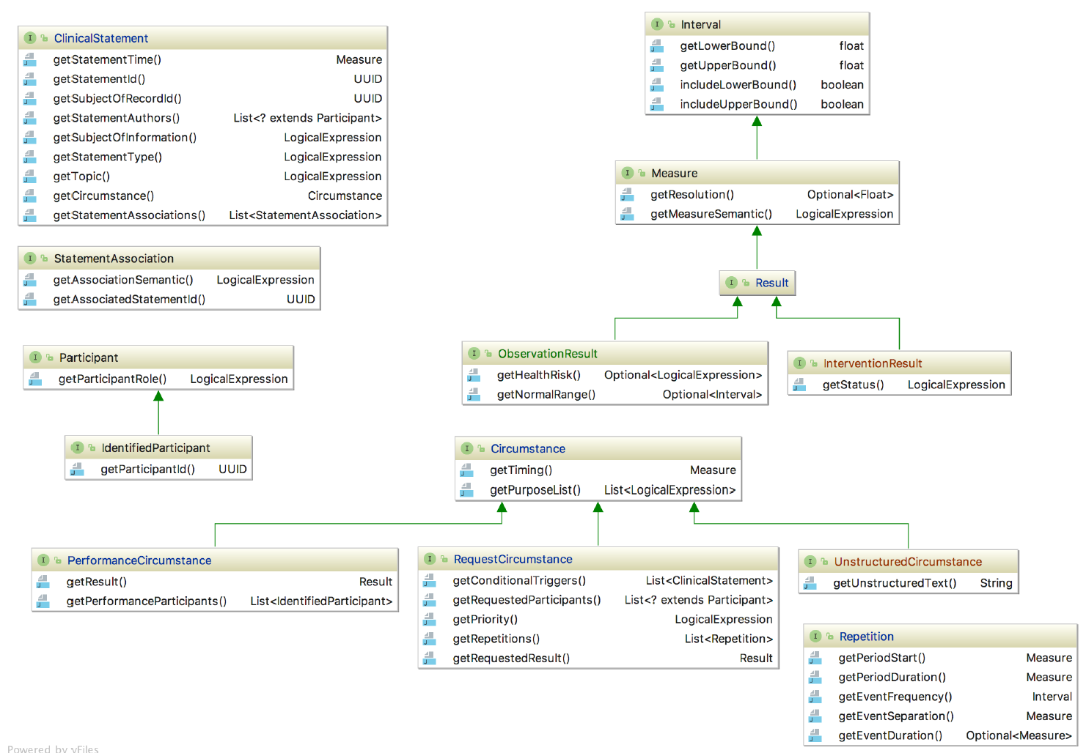
ANF Structure

Slide 15
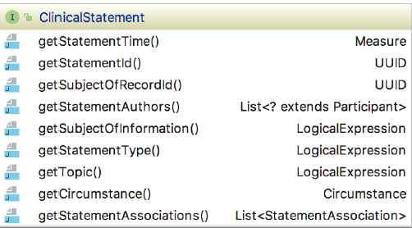
Statement
Who
What
How

Slide 16


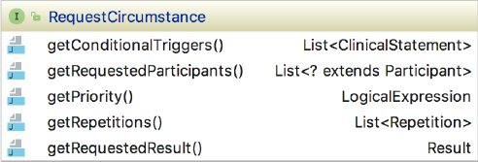
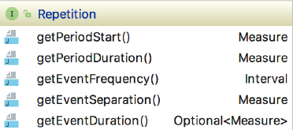
Circumstance

Slide 17
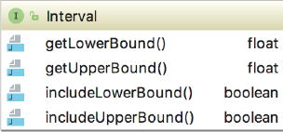




Measurement

Slide 18
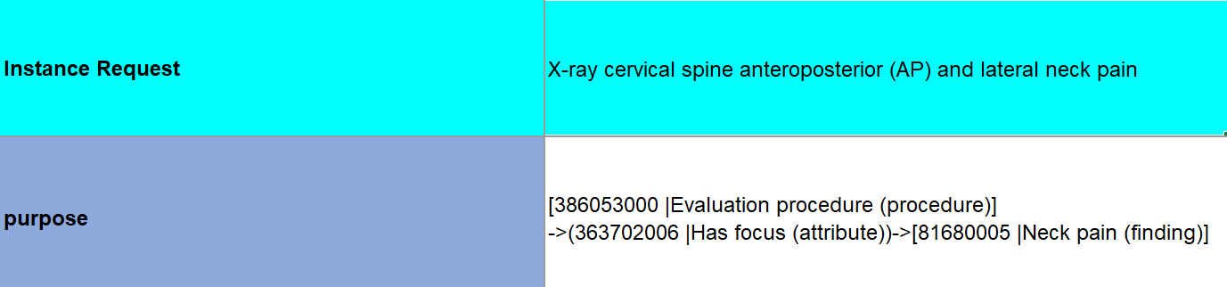
Request for action – X-Ray Procedure

Slide 19
Request for action – Medication Therapy
Statement Type: 385644000 |Requested (qualifier value)|
Action requested:
Administration of Ibuprofen 400 mg 1 tablet oral every 4 to 6 hours for neck pain
Topic post-coordinated expression
[416118004 |Administration (procedure)]
->(260686004 |Method (attribute))->[129445006 |Administration - action (qualifier value)]
->(363701004 |Direct substance (attribute))->[Rx;197805 Ibuprofen 400 MG Oral Tablet]
->(410675002 |Route of administration (attribute))->[260548002 |Oral (qualifier value)]

Slide 20
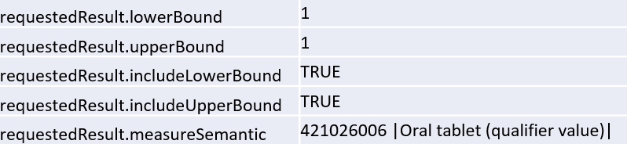
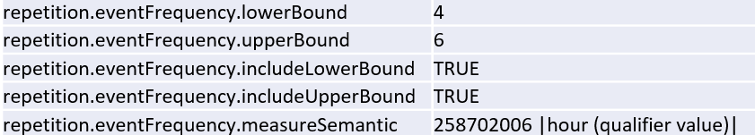
Request for action – Medication Therapy
Requested:
Administration of Ibuprofen 400 mg 1 tablet oral every 4 to 6 hours for neck pain

Slide 21
Observation – Enumerated Value
Statement Type: 398166005 |Performed (qualifier value)|
Observation:
Observation of colon cancer, stage I
Topic post-coordinated expression
Observation procedure (procedure)
->(363702006 |Has focus (attribute))->[363406005 |Malignant neoplasm of colon (disorder)]

Slide 22

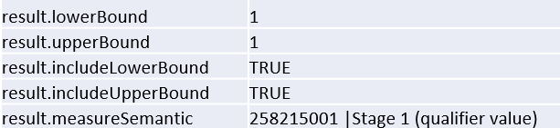
Observation – Enumerated Value
Observation:
Observation of colon cancer, stage I

Slide 23
Observation – Phenomenon
Statement Type: 398166005 |Performed (qualifier value)|
Observation:
Observation of chronic pain in lower back region
Topic post-coordinated expression
Observation procedure (procedure)
->(363702006 |Has focus (attribute))->[22253000 |Pain (finding)]-
->(363698007 |Finding site (attribute))->[37822005 |Lower back structure (body structure)]-
->(263502005 |Clinical course (attribute))->[90734009 |Chronic (qualifier value)];

Slide 24
False Dichotomies
“Measurement of systolic blood pressure on right brachial artery, using adult BP cuff, patient in sitting position for at least 5 minutes”
Prerequisite?
Precondition?
Technique?
Are they different?
How?

Slide 25
False Dichotomies
“Measurement of systolic blood pressure on right brachial artery, using adult BP cuff, patient in sitting position for at least 5 minutes”
Prerequisite?
Precondition?
Technique?
Are they different?
How?

Slide 26
Evolution
In the beginning was the word…
…which complicated things right away
…searching for true “meaning” and detecting false dichotomies was a big part of the work
Let there be light…
…in its youth, ANF was very heavy on topic types and “circumstances” – now it matured to be very light

Slide 27
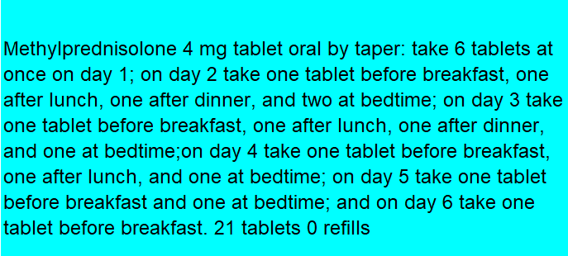
Evolution
There is still work to do
Not all Instance Requests can be fully modeled….
…….yet.

Slide 28
Discussion
Words are the beginning of all misunderstandings
----Oscar Wilde

Slide 29
APPENDIX

Slide 30
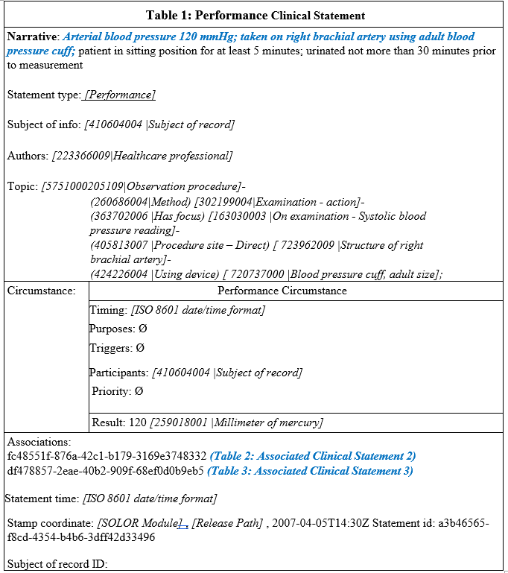
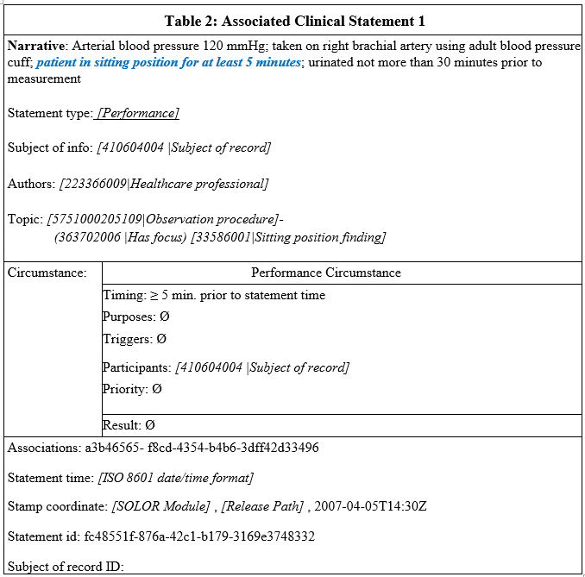
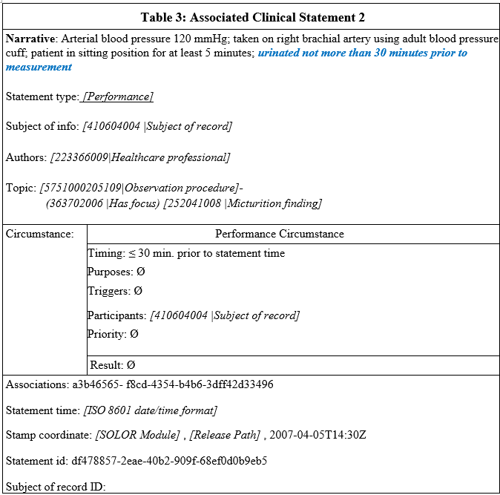
Example Performance Clinical Statement – Blood Pressure Measurement

Slide 31
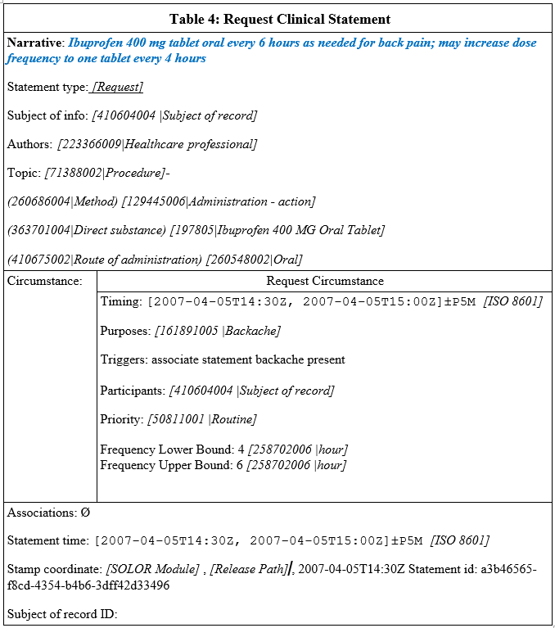
Example Request Clinical Statement – Medication Order

Slide 32
Example Performance Clinical Statement – HL7 C-CDA Summary of Care
Reason for Referral
Pulmonary Function Tests
Social History
Never smoked
Statement type: [Request]
Topic: [23426006 |Measurement of respiratory function]-
(260686004 |Method) [129266000 |Measurement – action]
Statement type: [Performance]
Topic: [5751000205109|Observation procedure]-
(363702006 |Has focus) [266919005 |Never smoked tobacco]
Problem List
Costal Chondritis
Asthma
Allergies, Adverse Reactions and Alerts
Allergen: Penicillin G
Reaction: Hives
Reaction severity: Severe
Statement type: [Performance]
Topic: [5751000205109|Observation procedure]-
(363702006 |Has focus) [64109004 |Costal chondritis]
Statement type: [Performance]
Topic: [5751000205109|Observation procedure]-
(363702006 |Has focus) [195967001 |Asthma]
Statement type: [Performance]
Topic: [5751000205109|Observation procedure]-
(363702006 |Has focus) [294499007 |Allergy to benzylpenicillin]
Associated statement:
Statement type: [Performance]
Topic: [5751000205109|Observation procedure]-
(363702006 |Has focus) [247472004 |Weal]-
(42752001 |Due to) [294499007 |Allergy to benzylpenicillin]-
(246112005 |Severity) [24484000 |Severe (severity modifier)]

Slide 33
Example Performance Clinical Statement – HL7 C-CDA Summary of Care
Height: 70 in
Statement type: [Performance]
Topic: [14456009 |Measuring height of patient]-
(260686004 |Method) [129266000 |Measurement - action]
Result: 70 [258677007 |Inch]
Statement type: [Performance]
Topic: [39857003 |Weighing patient]-
(260686004 |Method) [129266000 |Measurement - action]
Result: 195 [258693003 |pounds]
Statement type: [Performance]
Topic: [698094009 |Measurement of body mass index]-
(260686004 |Method) [129266000 |Measurement - action]
Result: 28 [260299005 |Number]
Statement type: [Performance]
Topic: [5751000205109|Observation procedure]-
(260686004|Method) [302199004|Examination - action]-
(363702006 |Has focus) [163030003 |On examination - Systolic blood pressure reading];
Result: 155 [259018001 |Millimeter of mercury]
Weight: 195 lb.
Vital Signs
Body Mass Index (calculated): 28
BP systolic: 155 mmHg

Slide 34
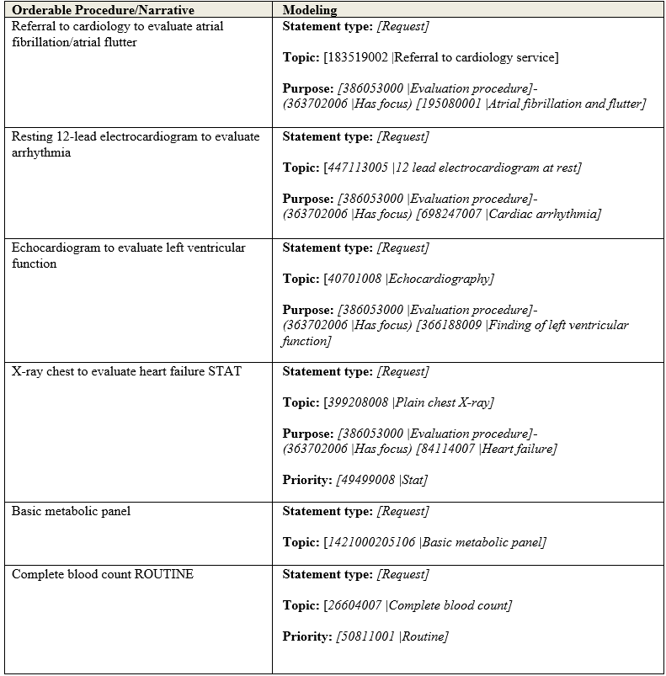
Example KNART Clinical Statements – Atrial Fibrillation / Atrial Flutter Order Set

Slide 35
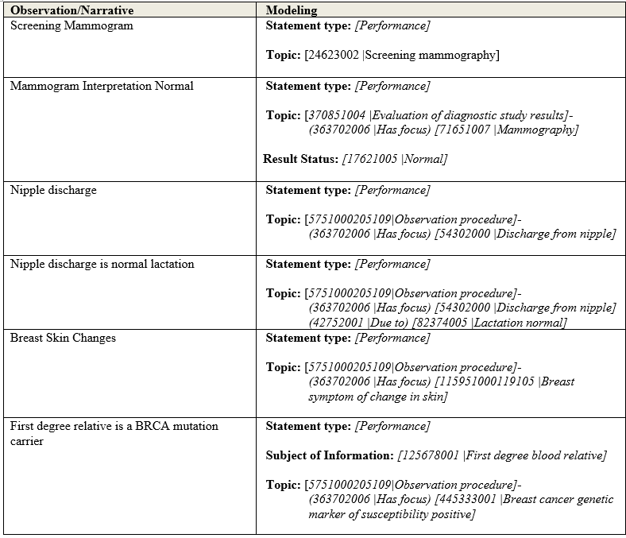
Example KNART Clinical Statements – Atrial Fibrillation / Atrial Flutter Order Set

